Slide 1
Classical Encryption
Techniques

Slide 2
Goal
To introduce basic concepts & terminology of encryption

Slide 3
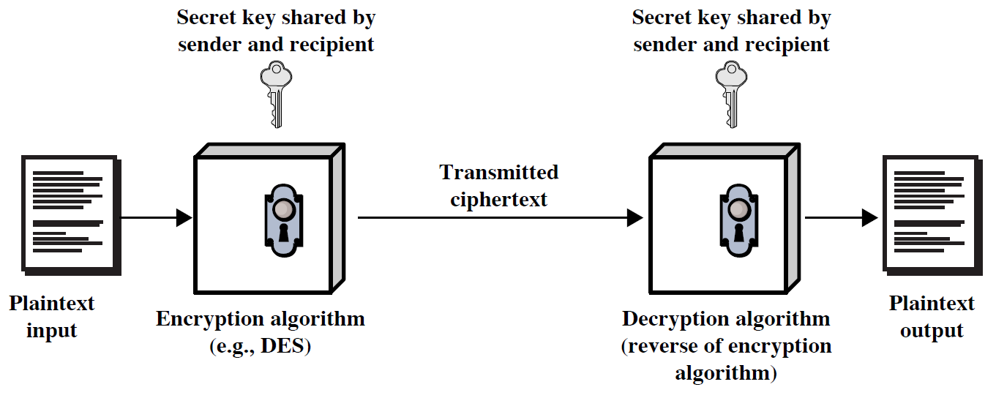
Symmetric Cipher Model

Slide 4
Caesar Cipher
Earliest known substitution cipher
Invented by Julius Caesar
Each letter is replaced by the letter three positions further down the alphabet.
  Plain: a b c d e f g h i j k l m n o p q r s t u v w x y z
  Cipher: D E F G H I J K L M N O P Q R S T U V W X Y Z A B C
Example: ohio state → RKLR VWDWH

Slide 5
Caesar Cipher
Mathematically, map letters to numbers:
  a, b, c, ..., x, y, z
  0, 1, 2, ..., 23, 24, 25
Then the general Caesar cipher is:
  c = E_{K}(p) = (p + k) mod 26
  p = D_{K}(c) = (c – k) mod 26
Can be generalized with any alphabet.

Slide 6
Cryptanalysis of Caesar Cipher
Key space: {0, 1, ..., 25}
Vulnerable to brute-force attacks.

Slide 7
Monoalphabetic Substitution Cipher
Shuffle the letters and map each plaintext letter to a different random ciphertext letter:
  Plain letters: abcdefghijklmnopqrstuvwxyz
  Cipher letters: DKVQFIBJWPESCXHTMYAUOLRGZN
  Plaintext: ifwewishtoreplaceletters
  Ciphertext: WIRFRWAJUHYFTSDVFSFUUFYA

Slide 8
Monoalphabetic Cipher Security
Now we have a total of 26! = 4 x 10²⁶ keys.
With so many keys, it is secure against brute-force attacks.
But not secure against some cryptanalytic attacks.
Problem is language characteristics.

Slide 9
Language Statistics and Cryptanalysis
Human languages are not random.
Letters are not equally frequently used.
In English, E is by far the most common letter, followed by T, R, N, I, O, A, S.
Other letters like Z, J, K, Q, X are fairly rare.

Slide 10
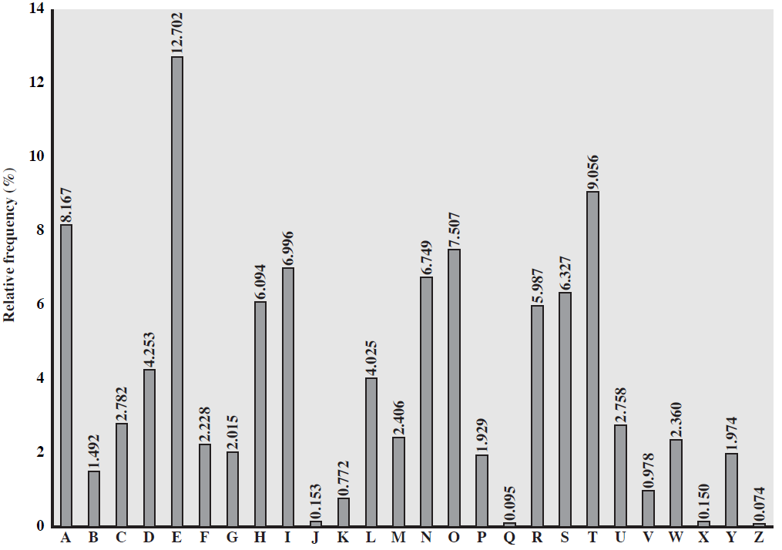
English Letter Frequencies

Slide 11
Use in Cryptanalysis
Key concept: monoalphabetic substitution does not change relative letter frequencies
To attack, we
  calculate letter frequencies for ciphertext
  compare this distribution against the known one

Slide 12
Polyalphabetic Ciphers
Polyalphabetic substitution ciphers
Improve security using multiple cipher alphabets
Make cryptanalysis harder with more alphabets to guess and flatter frequency distribution
Use a key to select which alphabet is used for each letter of the message

Slide 13
Playfair Cipher
Not even the large number of keys in a monoalphabetic cipher provides security.
One approach to improving security is to encrypt multiple letters at a time.
The Playfair Cipher is the best known such cipher.
Invented by Charles Wheatstone in 1854, but named after his friend Baron Playfair.

Slide 14
Playfair Key Matrix
Use a 5 x 5 matrix.
Fill in letters of the key (w/o duplicates).
Fill the rest of matrix with other letters.
E.g., key = MONARCHY.
M | O | N | A | R
C | H | Y | B | D
E | F | G | I/J | K
L | P | Q | S | T
U | V | W | X | Z

Slide 15
Encrypting and Decrypting
Plaintext is encrypted two letters at a time.
  If a pair is a repeated letter, insert filler like 'X’.
  If both letters fall in the same row, replace each with the letter to its right (circularly).
  If both letters fall in the same column, replace each with the the letter below it (circularly).
  Otherwise, each letter is replaced by the letter in the same row but in the column of the other letter of the pair.

Slide 16
Security of Playfair Cipher
A brute force attack on a Playfair cipher is very difficult. The size of the key domain is 25! (factorial 25).
Security is much improved over the simple monoalphabetic cipher.
Was widely used for many decades
  eg. by US & British military

